Slide 1

Clarusway Group Mentoring
(Week 4)

Slide 2


Slide 3
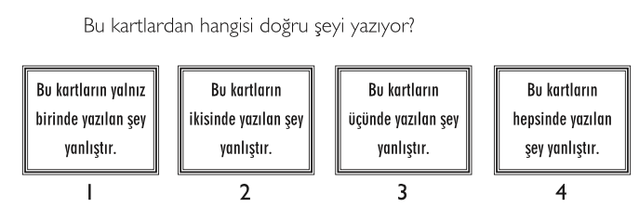
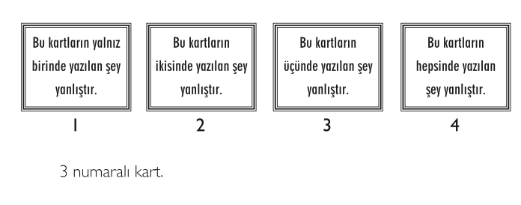
WARM UP QUESTIONS

Slide 4
QUESTIONS
What is Python?
Cevap: A: Python is a programming language. It allows you to control the computer. The benefits of Pythons are that it is simple and easy, portable, extensible.
What is PEP 8?
Cevap: PEP stands for Python Enhancement Proposal. PEP 8 is a coding convention, a set of recommendation, about how to write your Python code more readable. In other words, PEP 8 is a document that gives coding conventions for the Python code comprising the standard library in the main Python distribution.
3. Aşağıdakilerden hangileri PEP 8 convention ‘a göre doğrudur
A B
I. print('continent') print ('continent') (Doğru)
Immediately before the open parenthesis that starts the argument list of a function call:
II. if y == 3 : print x , y ; x , y = y , x (Doğru) if y == 3: print x, y; x, y = y, x
Immediately before a comma, semicolon, or colon :
III. df[0,] or foo = (2,) Doğru df[0, ] or foo = (2, )
Between a trailing comma and a following close parenthesis :

Slide 5
QUESTIONS
3. What are the comments and how do you write it in Python?
Cevap: Comments are used to explain code when the basic code itself isn't clear. Python ignores comments, and so will not execute code in there, or raise syntax errors for plain English sentences. Comments in Python start with a # character. '#' character converts all subsequent characters to the comment form that Python does nothing.
# this is a single line comment
print("Hello World!") # this is an inline comment
4. Why are giving variable name and writing comment on your code so important?
Cevap: Expert programmers care much for naming the variables well to make their codes easy to understand. It is important because programmers spend a lot of time reading and understanding code written by other programmers. Even you write your code, a couple of weeks later, you can not understand your own code if you didn’t give clear variable name and write ypour own comment about your code.

Slide 6
QUESTIONS
5. What are the numerical data types in Python and their properties?
Cevap:
Integers : they are whole numbers (positive, negative or zero), including no decimal point.
Floats : they stand for real numbers with a decimal point.
Complexes : they are written in the form, x + yj , where x is the real part and y is the imaginary part.
6. Describe the Boolean types in detail.
Cevap Boolean types are called bool and their values are the two constant objects True and False. They are used to represent truth values (other values can also be considered false or true).
In numeric contexts (for example, when used as the argument to an arithmetic operator), they behave like the integers 0 and 1, respectively.

Slide 7
QUESTIONS
7. Lütfen aşağıdaki codların çıktılarını söyleyiniz
print(type(32.6))
print(type(True))
print(type(‘True’))
print(type(‘56.8’))
print(type(3+4j))

Slide 8
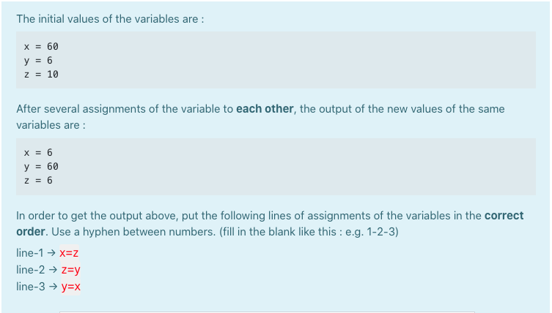
QUESTIONS
Verilen başlangıç değerleri ve çıktılar çerçevesinde uygulanacak dönüşün sırasını lütfen yazınız

Slide 9
QUESTIONS
9. What is an issue in JIRA Software?
Cevap. In Jira, teams use issues to track individual pieces of work that must be completed. During the sprint planning, users can create issues that they plan to work on and add them to the backlog.
10. List and briefly describe the issues types in Jira Software.
Cevap: Issue types can be defined in short sentences as follows:
A bug is a problem which impairs or prevents the functions of a product.
An epic is a big user story that needs to be broken down.
A subtask is a piece of work that is required to complete a task.
A user story is the smallest unit of work that needs to be done.
A task represents work that needs to be done.
The hierarchy for units of work in Jira Software is as follows: Project > Epics/Components > Stories > Tasks > Subtasks
Teams can customize the names of issue types to match their specific project requirements.
Each issue type can have different fields, screens and workflows.

Slide 10
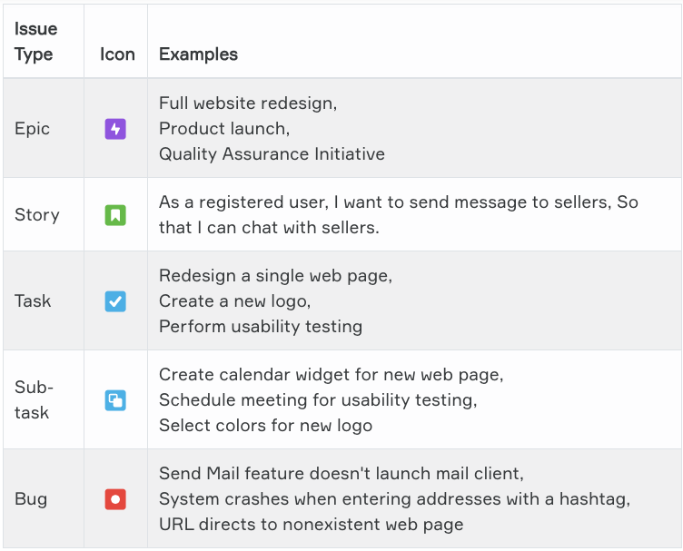
QUESTIONS

Slide 11
ADVICE FROM CLARUSWAY
Is there anything distracting you?
https://www.lifehack.org/articles/productivity/10-critical-tips-prevent-distraction-and-sharpen-your-focus.html

Slide 12

CLARUSWAY
YOUR QUESTIONS?

